Slide 1
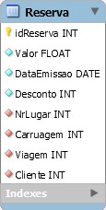
1
●
SELECT
2
INSERT
●

Slide 2
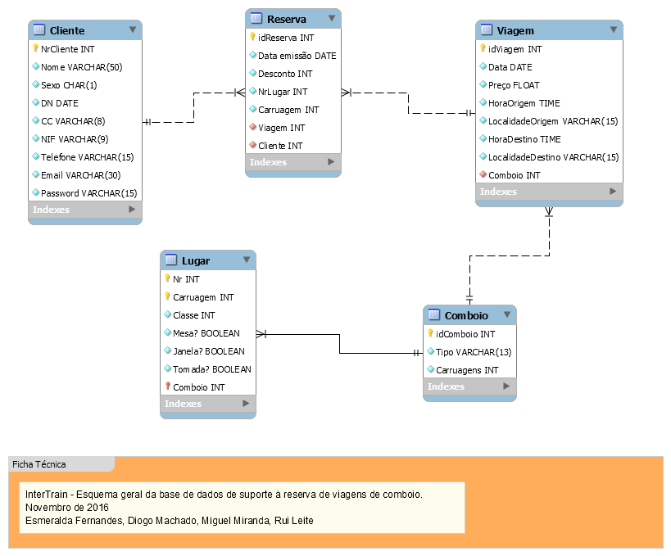
1
●
UPDATE
2
UPDATE
●

Slide 3
1
●
INSERT
●

